Slide 1
BUSINESS SUCCESSION PLANNING SEMINAR

Slide 2
What is succession planning?
Ensuring your business survives you
1
Enabling you to extract value at retirement
2

Slide 3
Does your business have value?
What value does it have without you?
Where is the value?
Is it dependent on key individuals?
Is it dependent on IP?
Long term customers?
Diversity of client base?

Slide 4
What if the value is dependent on you?
The impact is mostly on timing
Time to prepare
Time taken to receive value:
Need to stay involved for a period
If 3rd party sale - (earn-out)

Slide 5
Who is going to give value?
In or outside the tent?
Family members – appetite / aptitude?
Will they be paying?
How do you get your value out? – share buyback?
How do you ensure an income in retirement – special class of shares?
Management buy out
Types of management buy outs – VC or ”Friendly”?
Source of funds – VC/bank/other funding or company’s future income?
What does a VC backed MBO look like?
MBO or MBI?
VC exit expectations

Slide 6
Third party sales – ROUTES TO finding a buyer
Competitor (care required)
Accountants
Corporate Finance Advisor

Slide 7
Steps to sale
STEP 1: Prepare your business for sale:
Contracts
People
IP protection
Premises
STEP 2: Seek Professional advice early
STEP 3: Confidentiality
STEP 4: Timescales

Slide 8
Tying your employees in
Why is incentivising employees key to business succession?
Retaining the right candidate
Age issues?
Retention issues in family businesses
Importance of retaining staff ahead of a business sale

Slide 9
Tying your employees in employee share schemes
What are employee share schemes?
Offered by almost all UK Listed companies, but increasingly used by private companies too
What is a share option?
Broadly divided into tax-advantaged share schemes and non tax-advantaged share schemes
Tax-advantaged schemes –usually classified by the employees who participate. Most commonly companies will use all-employee schemes or discretionary schemes (often only open to directors). There are four main types:
Company Share Options Plans (CSOPs)
Save as you earn, sharesave, or savings-related option schemes (SAYE)
Enterprise management incentives (EMI) options
Share Incentive Plans (SIPs)
Non tax-advantaged share option schemes – there are various types of schemes but for private limited companies, the mostly commonly used are similar to CSOPs but without statutory requirements

Slide 10
Tying in staff – other incentives
Shares are not the only way to tie in employees
Incentives are commonly used to refer to share plans but there are other benefits the business can offer which can help promote increased staff retention as well as assist in recruiting the best talent, including:
Private medical insurance, income protection or critical illness cover
Cash health plans
Increased pension contributions
Bonus schemes
Additional holiday
Company paid parental leave
“Flex plans”
No incentive can replace competitive pay, good management, and an enjoyable working environment

Slide 11
Employing Gen z
A common problem businesses having is an aging workforce which can cause issues with succession planning.
Millennials (aged 25-40(ish)) vs. Gen Z (aged 9 to 24(ish)).
Gen Z cares most about work-life balance and personal well-being. Income and brand reputation is the least important.
Flexible working, homeworking, and hybrid working have been accelerated by Covid but are predicted to become the norm.
Gen Z care about social responsibility and are more likely to choose interesting working and a company committed to broader issues such as climate change, sustainability and charity.
Workplace diversity is one of the key things Gen Z look for when job hunting.

Slide 12
tips for the next generation
Your team vs my team
Moving on the old team and starting again?
Getting the team on side:
Concerns about modernising
New incentives
Get to work
Ask for help and opinions
If nothing else works – use your procedures

Slide 13
Preparing for sale – hr issues
Getting your contracts in order
Confidentiality
Restrictive covenants
What buyers will be looking for
Is pay in line with market rate?
What is the culture like?
Do you have outstanding complaints or tribunal claims?
Do you have underperforming employees?
Resolving workplace issues
Assess the problem
Look at your existing policies
Take advice

Slide 14
Mental incapacity of a director
Know what your articles say
- Table A (many versions – sectioned / 6 month absence / subject to deputyship)
- Model Articles (1st October 2009 onwards – registered medical practitioner)
- Bespoke Articles
Size of board
- Small (an attorney may be appropriate – do the articles allow this?)
- Large (usually best to leave the remaining directors to get on with it)

Slide 15
Will planning with use of business relief trusts
Married Couples
Incentivisation of key workers
Herve & Ulla-Maja
- Successful manufacturing business worth £1m
- 50/50 shareholdings
- £900k house, £600k savings
- 2 children, Jukka and Elina (Jukka works in the business)

Slide 16
without Trust (herve dies 1st)
Herve’s Will passes everything to Ulla-Maja. Her estate will therefore contain:
- £1m business shares
- £900k house, £600k savings (total £1.5m)
Gross Value of Estate for IHT = £2.5m
Less:
Nil Rate Band (NRB) = (£325,000)
Transferable NRB = (£325,000)
Residential NRB (RNRB) = (£50,000) Taper threshold £2m
Transferable RNRB = (£50,000)
Business Relief = (£1m)
Net Value of Estate for IHT = £750,000
IHT @ 40% = £300,000

Slide 17
With Trust (herve dies 1st)
Herve’s Will passes his shares into a BR Trust and everything else to Ulla-Maja. Ulla-Maja’s estate will therefore contain:
- £500k business shares
- £900k house, £600k savings (total £1.5m)
Gross Value of Estate for IHT = £2m
Less:
Nil Rate Band (NRB) = (£325,000)
Transferable NRB = (£325,000)
Residential NRB (RNRB) = (£175,000)
Transferable RNRB = (£175,000)
Business Relief = (£500k)
Net Value of Estate for IHT = £500,000
IHT @ 40% = £200,000

Slide 18
With Trust (herve dies 1st)
Herve’s Will passes his shares into a BR Trust and everything else to Ulla-Maja. Ulla-Maja immediately buys the shares from the trust and survives by 2 years. Her estate will therefore contain:
- £1m business shares
- £900k house, £100k savings (total £1m)
Gross Value of Estate for IHT = £2m
Less:
Nil Rate Band (NRB) = (£325,000)
Transferable NRB = (£325,000)
Residential NRB (RNRB) = (£175,000)
Transferable RNRB = (£175,000)
Business Relief = (£1m)
Net Value of Estate for IHT = £0
IHT @ 40% = £0
Poll
Is it sensible for Ulla-Maja to spend almost all her savings?

Slide 19
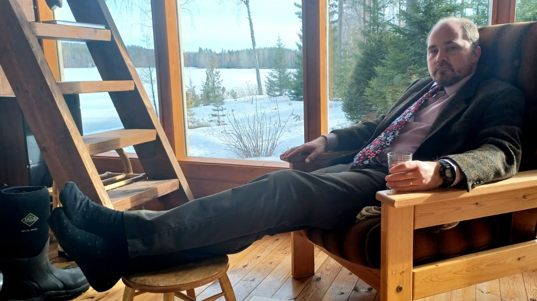
Incentivising jukka
Parents want to treat children equally
That might devalue your business
Same principle applies to other key workers

Slide 20
Cross-option agreements
Ongoing directors may wish to retain the business shares. Families often want cash.
Keyman insurance – make sure the business has working capital if a shareholder dies.
Cross-option agreements – give the business an option to purchase shares from a deceased shareholder and the shareholder’s estate an option to sell to the business with an agreed mechanic.
Must build in discretion otherwise Business Relief is lost.
Review old agreements.

Slide 21
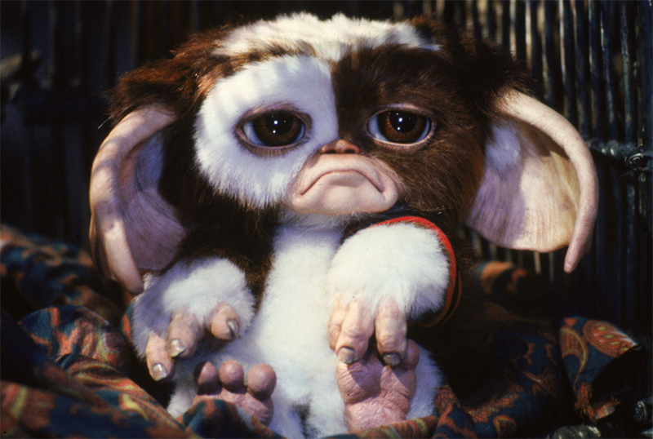
Other Gremlins in your Articles
Rights of pre-emption (might be ok but what about valuation mechanic)
Inability to transfer shares into trust
Inability to transfer shares other than to ‘defined’ family members

